Slide 1


ROOMY
Team Members
Huzaifa Malik
Huzaifa.ma@northeastern.edu
Jishnu Jemunigani
jemunigani.j@northeastern.edu
Keerthi Nethiguntla
nethiguntla.k@northeastern.edu
Juttu Gajendra Anurag
gajendraanurag.j@northeastern.edu

Slide 2

What is ROOMY ?
The Room Booking System is a web-based platform designed to facilitate the easy listing and booking of accommodations. Users can create listings for their available spaces, browse and contact postings, and process transactions securely. This application aims to streamline the process of finding short-term rentals for users by providing a user-friendly interface and a robust backend.

Slide 3






For managing user subscriptions
Azure Blob and Email service

Slide 4
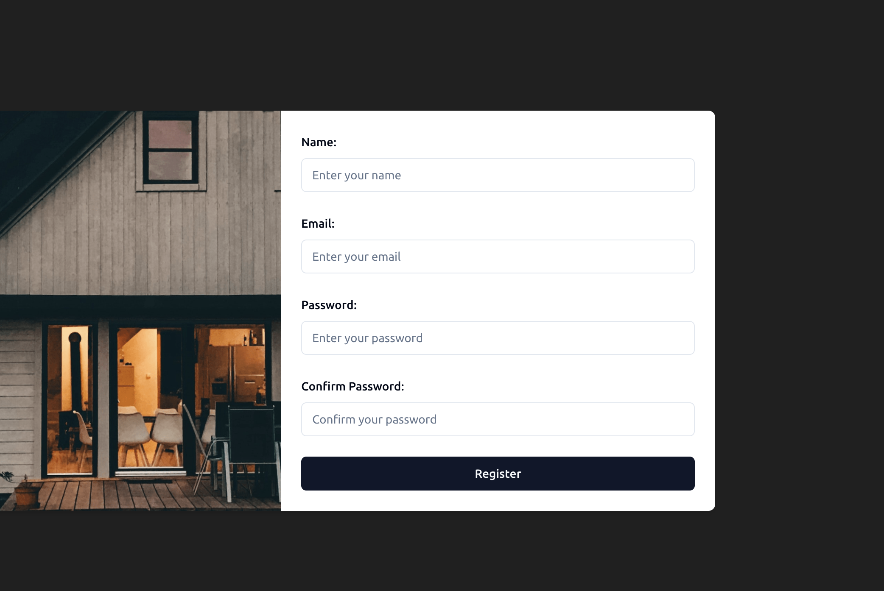
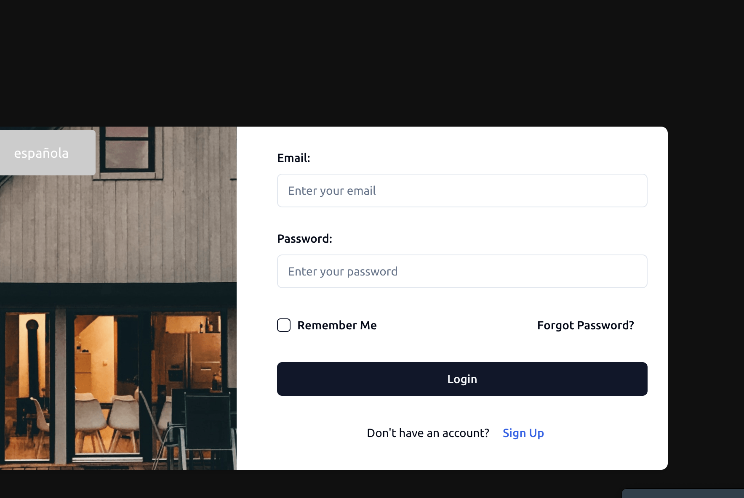
User App Authentication

Slide 5
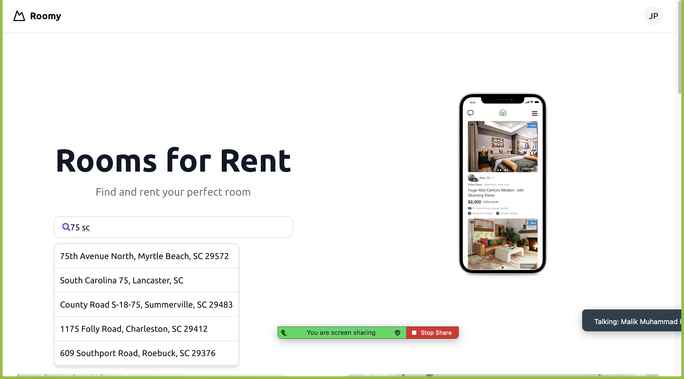
User App Homepage

Slide 6
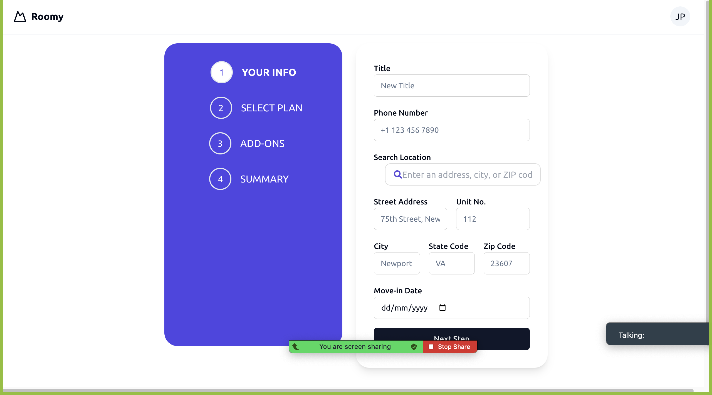
Listing a Place

Slide 7
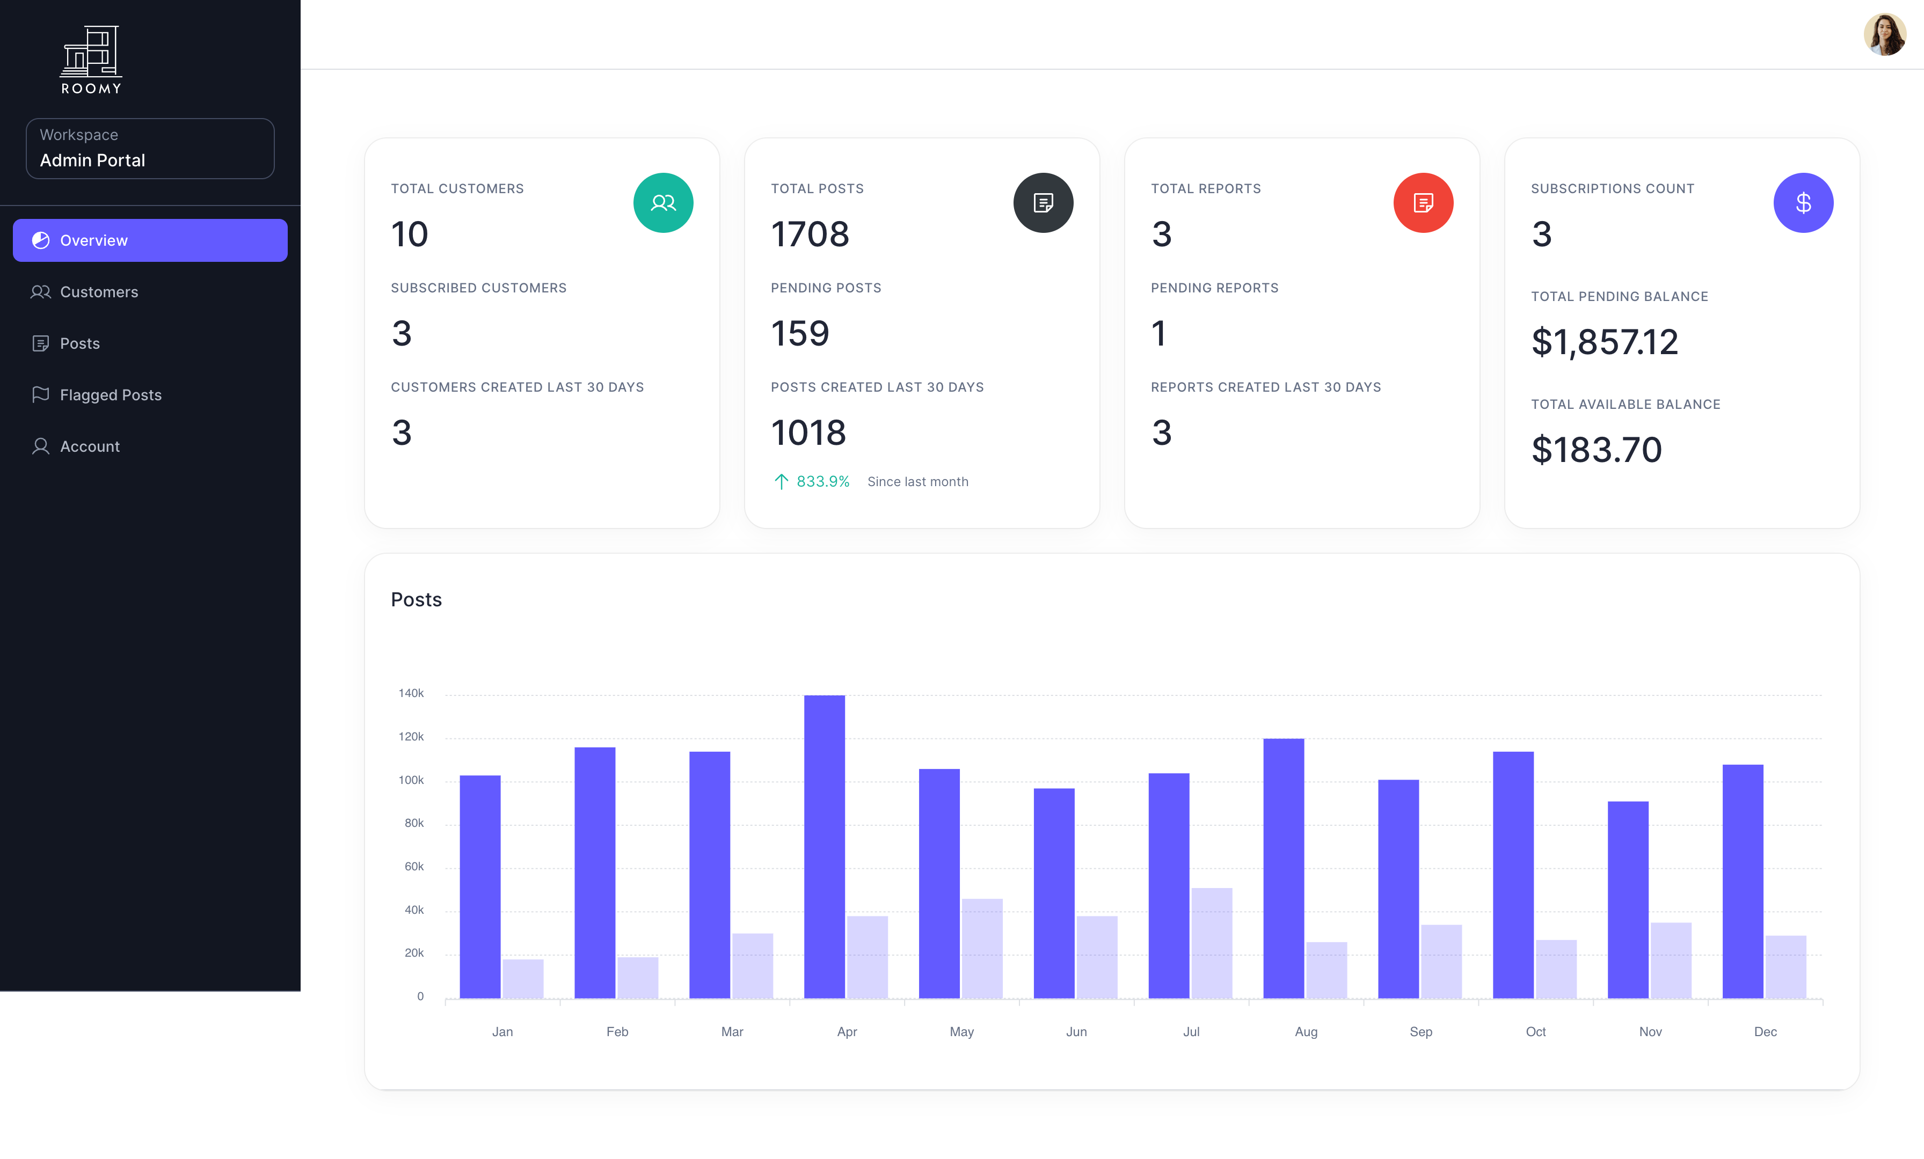
Admin Landing page

Slide 8
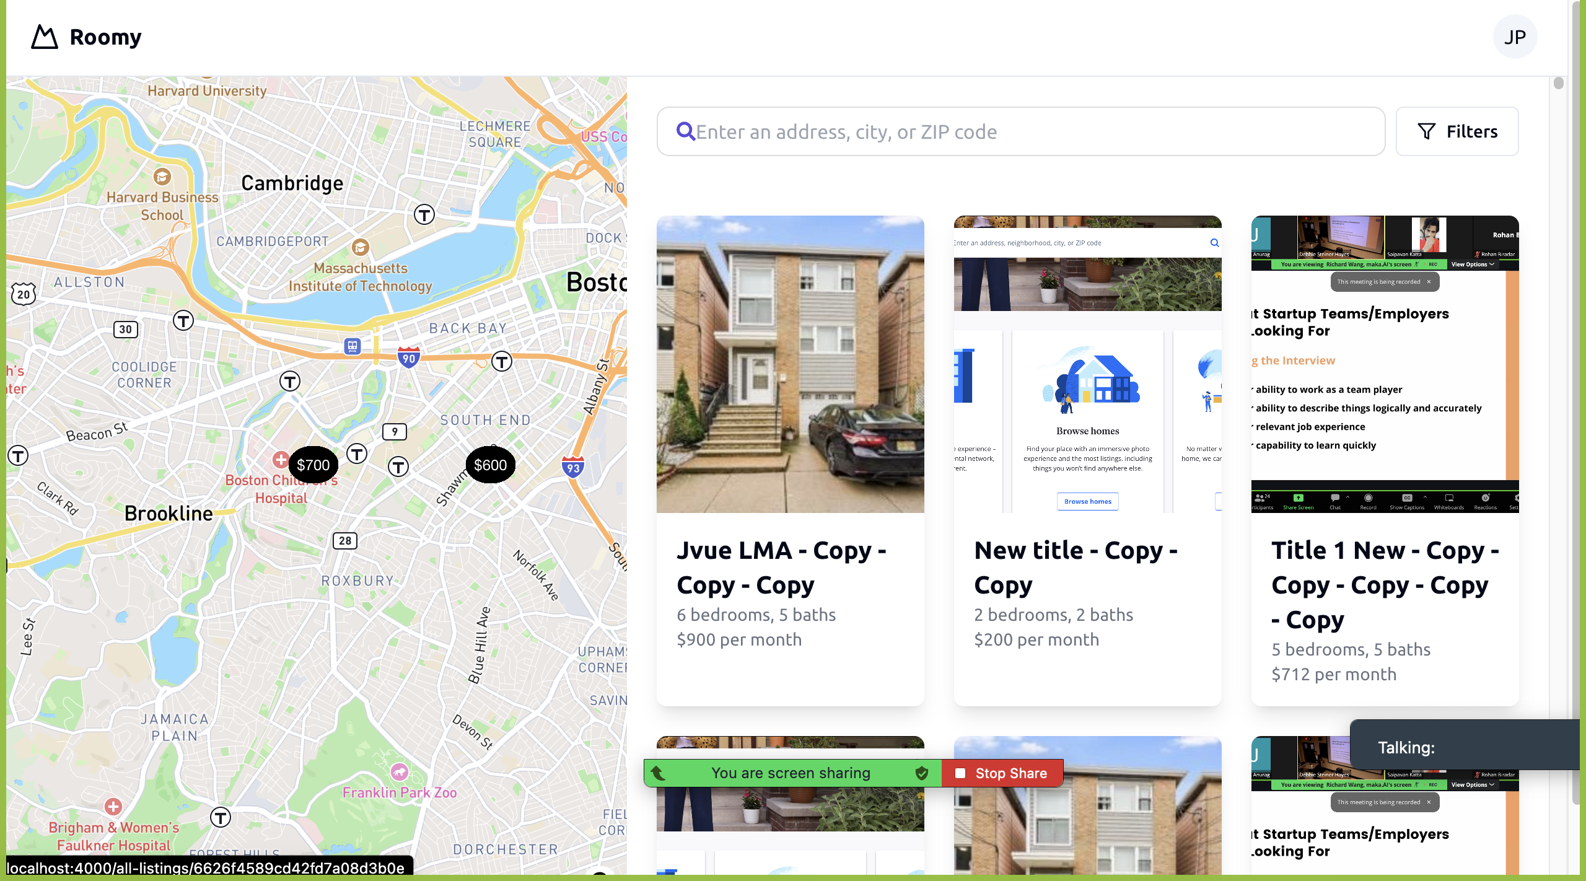
Finding a Place

Slide 9
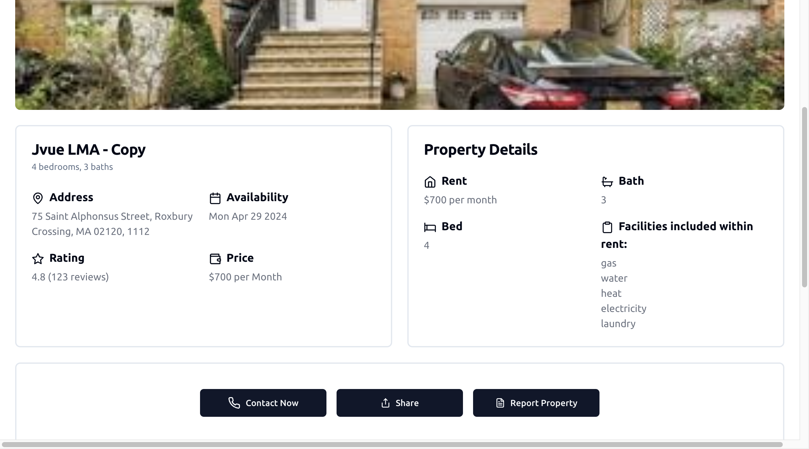

Slide 10
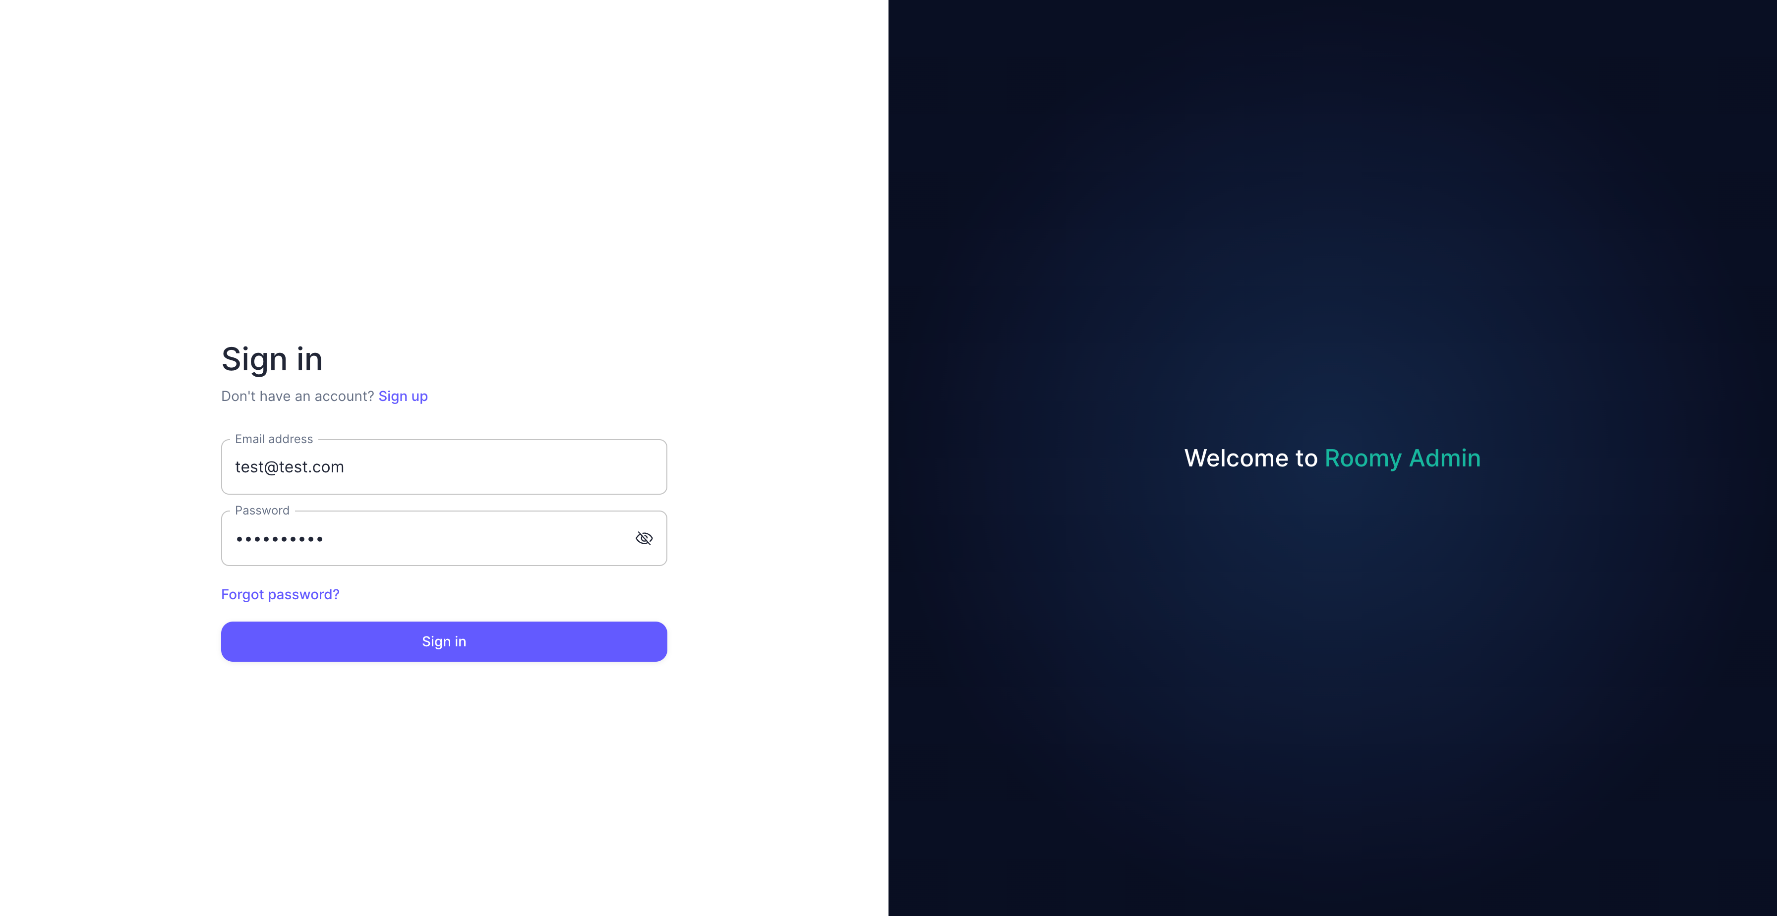
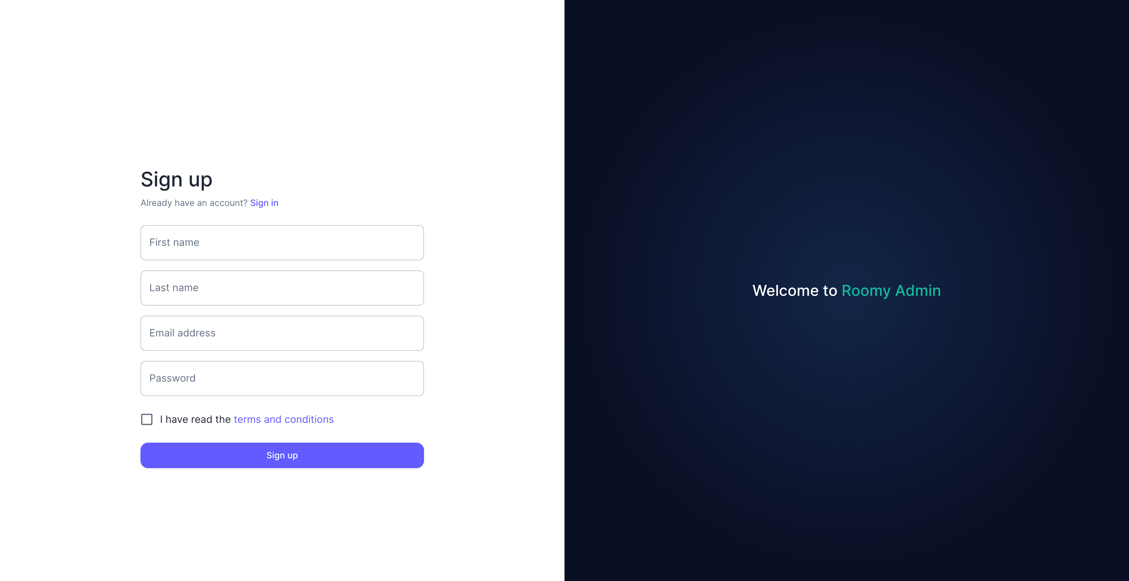
Admin App Authentication

Slide 11
Admin Landing page

Slide 12
Functionalities
User
Authentication: Users have the option to log in or sign up to access their accounts securely.
Listing Creation: Users can create detailed listings, including comprehensive information and photo uploads.
Listing Exploration: Users can browse through a variety of listings using advanced filters and view them on an interactive map to locate properties in their vicinity.
Subscription Management: Users can subscribe to different payment plans and easily manage their subscription preferences.
Account Administration: Users have the ability to oversee their account settings, including profile details and password updates, ensuring a personalized experience.
Admin
Authentication: Administrators can log in or sign up to access their dashboard. The dashboard includes detailed statistics and graphs.
User Management: Administrators can view all users and delete users along with their associated posts.
Post Management: Administrators can view all posts and delete individual posts.
Post Approval: When a user creates a listing, it is initially in a pending state. Administrators can review and approve listings.
Post Deactivation: If a user reports a listing as inappropriate, the request is sent to the administrator for review. The administrator can then deactivate the reported post after reviewing it.

Slide 13
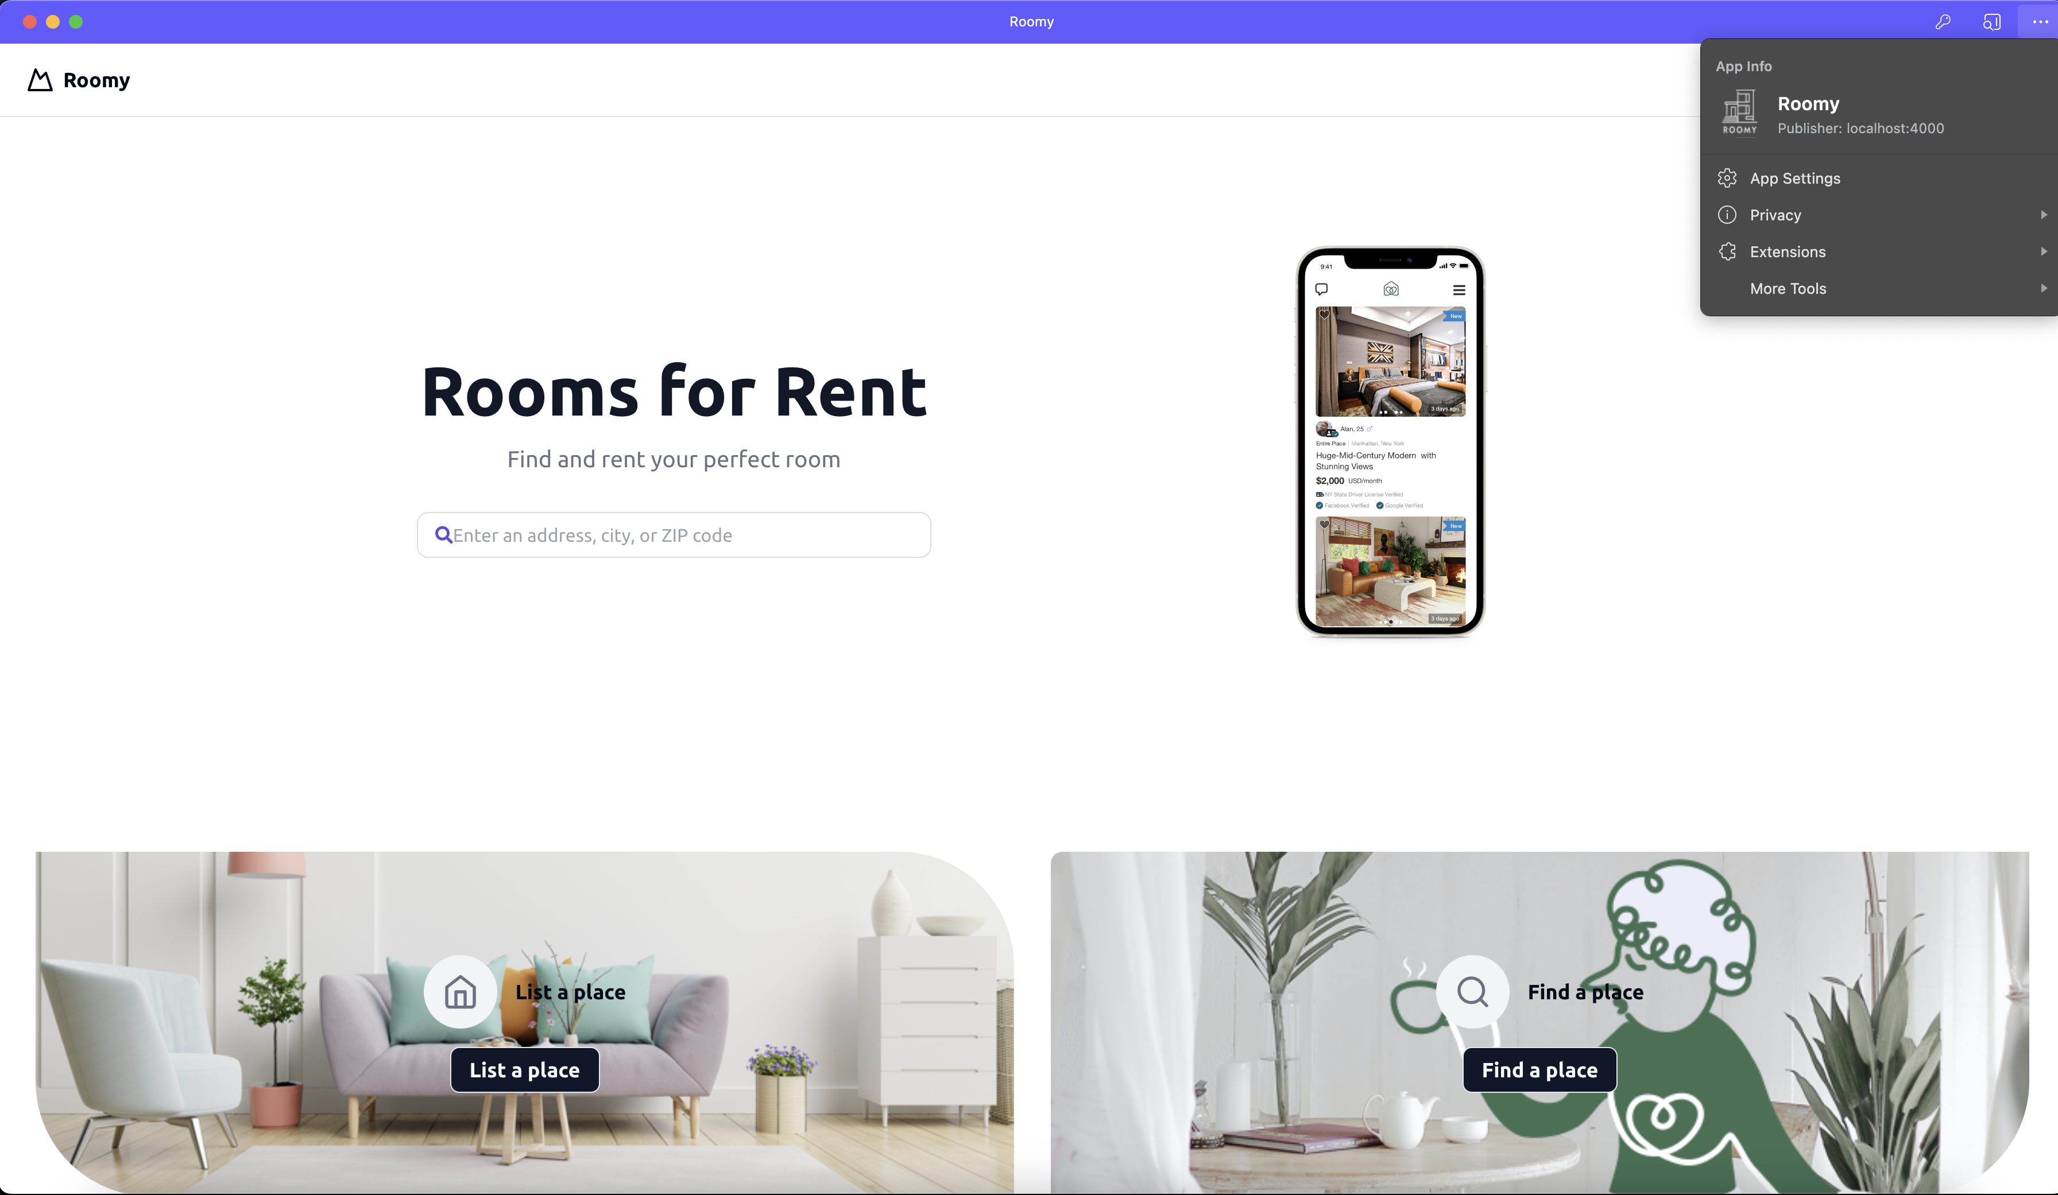
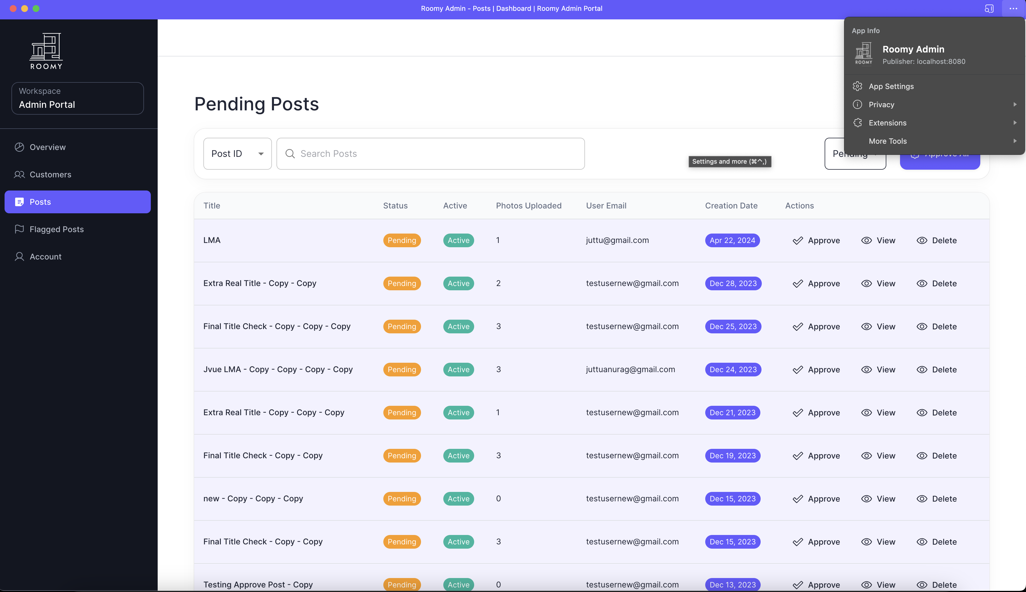
Progressive Web Apps

Slide 14
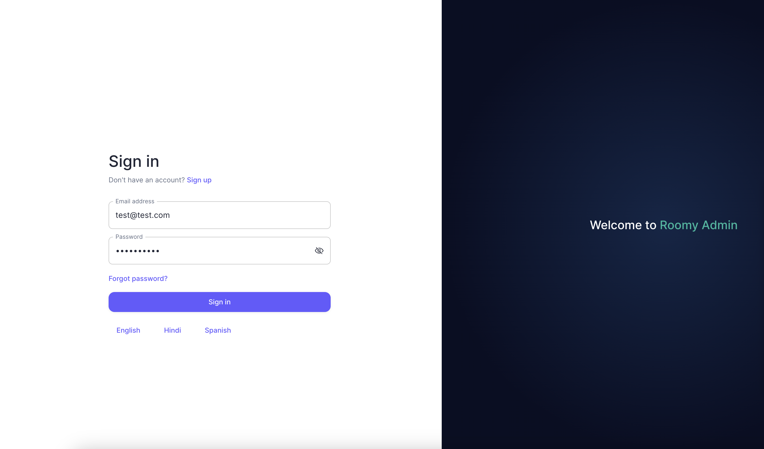
Internationalization (i18n)

Slide 15

THANK YOU
https://github.com/info-6150-spring-2024/final-project-roomy

